Slide 1

Erstellen einer Datenverarbeitungsarchitektur zum Erstellen und Verwenden von Modellen Maschinellen Lernens im Qualitätsmanagement
Bildquelle: https://www.pexels.com/photo/low-angle-shot-of-high-rise-building-2096578/
Lars Grespan

Slide 2
AGENDA
Problemstellung
Architektur
Ergebnisse
Ausblick
Fragen

Slide 3

Problemstellung
Bildquelle: https://www.pexels.com/photo/black-and-white-blackboard-business-chalkboard-356043/

Slide 4
ProblemstellungG
Ausgangssituation
Proaktive Fehlervermeidung in der Produktion durch Maschinelles Lernen
ML-Modell Training vs. Fehlervorhersagen
Probleme und Herausforderungen bei Datenanalysen im Produktionsumfeld
Ziel: Einheitliche Datenverarbeitung

Slide 5
Problemstellung
Forschungsfragen
RQ1:
Inwieweit lässt sich eine einheitliche Datenverarbeitung in Form von gleichem Source Code für die Erstellung der ML-Modelle als auch für die Verwendung der ML-Modelle zur Fehlervorhersage erstellen?
RQ2:
Wie kann eine Datenverarbeitungsarchitektur aussehen, bei der für die Erstellung der ML-Modelle dieselbe Datenverarbeitung durchlaufen wird, wie für die Verwendung der ML-Modelle zur Fehlervorhersage?
RQ3:
Ist eine solche Architektur umsetzbar?
RQ4:
Welche Technologien eigenen sich hinsichtlich der Performance für eine solche Datenverarbeitungsarchitektur am besten?

Slide 6

Architektur
Architektur
Bildquelle: https://www.pexels.com/photo/clear-light-bulb-on-black-surface-356043/
Bildquelle: https://www.pexels.com/photo/structural-photography-of-structure-1738986/

Slide 7
Architektur
Event Processing System
Data Scientist
Event Processing System
[Software System]
The event processing system is responsible for generating data, simulating test stations, processing events, training and creating ML models, generating predictions, displaying predictions and displaying the results.
Trains ML-models
Quality Engineer
Views prediction results

Slide 8
Architektur
REST Implementation
Data model
[Component: Python]
Test station meta information
Creates Data Model
Data Scientist
Loads Data Model
Starts event generation
Event generation
[Container: Python]
Event data generation
EventDB
[Container: MongoDB]
Stores created events
Starts test station event simulation
Reads and writes csv files
Reads and writes processed events
Simulate test stations
[Container: Python]
Sending Events from the test stations
Reads events
Starts REST Webservice
Event processing
[Component: Python]
Processing of events
Performs ML Model training
Reads and writes results
Makes REST API Calls
Processing server
[Container: Python]
REST Webservice to receive events, make predictions and to show the results
Processes received events
Quality Engineer
Views results on the website [https]
Reads events
Loads ML models
Processes events
File System
[Container: Local Directory]
Model training
[Container: Python]
ML Model training
Stores ML models
Event Processing System [Software System]

Slide 9
Architektur
Change Streams Implementation
Data Model
[Component: Python]
Test station meta information
(Create csv-files)
Creates Data Model
Event generation
[Container: Python]
Event data generation
(Create csv-files)
Loads Data Model
Starts event generation
Stores created events
EventDB
[Container: MongoDB]
Data Scientist
Reads and writes csv files
Starts test station event simulation
Simulate test stations
[Container: Python]
Test station event creation
Reads events
Reads and writes results
Reads and writes processed events
Starts change streams service
Reads csv files
Trigger change streams service
Event processing
[Component: Python]
Processing of events
Change Streams Service
[Container: Python]
React on an event creation (make predictions)
Starts REST Webservice
Processes events
Performs ML Model training
Reads events
Loads ML models
Quality Engineer
Result presentation
[Container: Python]
Webservice to show the results
Views results on the website [https]
Reads events
File System
[Container: Local Directory]
Processes events
Model training
[Container: Python]
ML Model training
Stores ML models
Event Processing System [Software System]

Slide 10
Architektur
Event Generation (REST + Change Streams)
Start Data Generation
[Component: Python]
Pass CMD arguments to datagen script
Data Generation
[Component: Python]
csv- file creation
Creates csv files using CMD arguments
Saves csv-files reads config files
File System
[Container: Local Directory]
Starts event generation CMD arguments: config file name, number of events, csv-file name
Test station config
[Component: Yaml]
Config file for creating test station data set
Saves files on local directory
Data Scientist
Creates config files
EventDB
[Container: MongoDB]
Reads csv files
Starts storing process
Store events
Store Data
[Component: Python]
Stores dependent events
Create Dependencies
[Component: Python]
Creates dependencies among the different csv-files
Calls create_dependencies script
Event generation [Container]

Slide 11
Architektur
Model Training (REST + Change Streams)
ML Model Training
[Component: Python]
Trains ML models with processed events and loaded label
File System
[Container: Local Directory]
Saves ML models
Calls ML model training
Start Batch Training
[Component: Python]
Pass CMD arguments and triggers batch ML model training
Event processing
[Container: Python]
Processing of events
Data Scientist
Performs batch ML model training CMD arguments: teststation, product_type
Calls event processing
Calls Load Label
Reads events
Load Label
[Component: Python]
Load Label from the processed events from the next test station
EventDB
[Container: MongoDB]
Reads processed events
Model training [Container]

Slide 12
Architektur
Event Processing (REST + Change Streams)
Clean Events
[Function: Python]
Data Model
[Component: Python]
Meta information for deviating features and cleaning data
Change Streams Service
[Container: Python]
React on an event creation (make predictions)
Gets drop list
Creates Data Model
Data Scientist
Calls pre-processing
Gets feature and value dict
Processing Server
[Container: Python]
REST Webservice to receive events, make predictions and to show the results
Process Events
[Function: Python]
Pass CMD arguments and triggers batch ML model training
Derive Events
[Function: Python]
Calls event
Calls derivation
Calls Store Data
Calls event
Store Events
[Function: Python]
Calls merge events
Model training
[Container: Python]
ML Model training
Merge Events
[Function: Python]
Merge Events among test stations
Writes events
EventDB
[Container: MongoDB]
Reads and writes events
Event Processing [Container]

Slide 13
Architektur
Simulate Test Stations (REST)
Start sending Events
[Component: Python]
Pass CMD arguments and start sending event to REST Server procedure
Starts test station event simulation CMD arguments: teststation, product_type
Reads events
Data Scientist
EventDB
[Container: MongoDB]
Calls rest script to send events
Send to REST Server
[Component: Python]
Loop over events in consideration of CMD arguments) and send them to the REST Server
Simulate test stations [Container]
Makes REST API Calls
Processing Server
[Container: Python]
REST Webservice to receive events, make predictions and to show the results

Slide 14
Architektur
Simulate Test Stations (Change Streams)
Create Dependencies
[Component: Python]
Creates dependencies among the different csv-files
Calls create_dependencies
Store Data
[Component: Python]
Stores dependent events
EventDB
[Container: MongoDB]
Data Scientist
Starts test station event simulation
Stores events
Reads csv files
Triggers response of change streams service
File System
[Container: Local Directory]
Simulate test stations Container]
Change Streams Service
[Container: Python]
React on an event creation (make predictions)

Slide 15
Architektur
Processing Server (REST)
Simulate test stations
[Container: Python]
Sending Events from the test stations
File System
[Container: Local Directory]
Makes REST API calls
Loads ML Models
Data Scientist
Start REST Server
[Component: Python]
Start Server and pass CMD arguments
Process Events Service
[Component: Python]
Receive events, load corresponding ML models and make predictions
Starts server CMD arguments: teststation, product_type
Starts service
Calls event processing
Event processing
[Container: Python]
Processing of events
Starts service
Saves prediction results
Show Results Service
[Component: Python]
Create Website with result table
Quality Engineer
Views results [https]
Reads results
EventDB
[Container: MongoDB]
Processing Server [Container]

Slide 16
Architektur
Change Streams Service (Change Streams)
Simulate test stations
[Container: Python]
Test station event creation
File System
[Container: Local Directory]
Trigger change
stream service
Loads ML Models
Data Scientist
Start Change Stream Service
[Component: Python]
Start Change Stream Service. Pass CMD arguments
Change Stream Service
[Component: Python]
Receive events, process events (in consideration of the CMD arguments),
load corresponding ML models and make predictions
Event processing
[Container: Python]
Processing of events
Starts server CMD arguments: teststation, product_type
Starts service
Calls event processing script
Saves prediction results
EventDB
[Container: MongoDB]
Change Streams Service [Container]

Slide 17
Architektur
Result Presentation(Change Streams)
Start Webservice
[Component: Python]
Start Webservice
Data Scientist
Starts webservice
EventDB
[Container: MongoDB]
Starts service
Reads results
Show Results Service
[Component: Python]
Create Website with result table
Quality Engineer
Views results [https]
Result Presentation [Container]

Slide 18

Ergebnisse
Bildquelle: https://www.pexels.com/photo/adult-books-business-coffee-374016/
Bildquelle: https://www.pexels.com/photo/iphone-notebook-pen-working-34088/
Bildquelle: https://gsp-architekten.de/projekt/microsoft-headquarter-deutschland-muenchen/

Slide 19
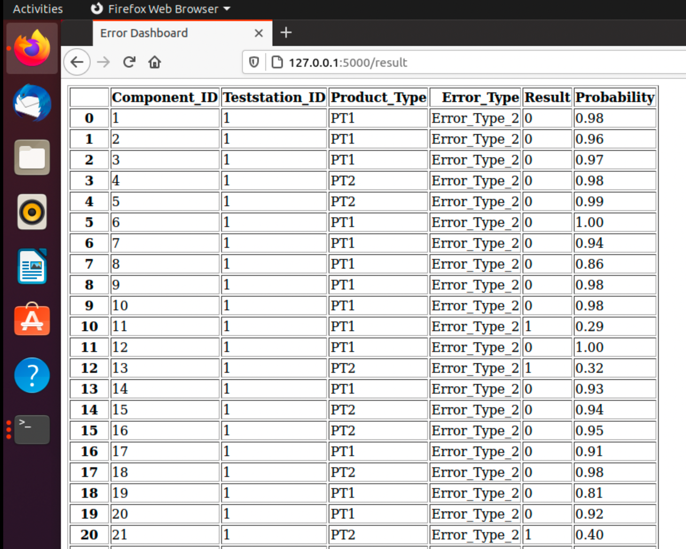
Ergebnisse
Error Dashboard

Slide 20
Ergebnisse
Performancetests
Teststationen/ Produkttypen | REST Implementierung | Change Streams Implementierung
All / All | 5 Minuten 45 Sekunden | 6 Minuten 14 Sekunden
T1/ All | 2 Minuten 21 Sekunden | 3 Minuten 3 Sekunden
T1 / PT1 | 1 Minute 13 Sekunden | 1 Minute 35 Sekunden
T1 / PT2 | 1 Minute 11 Sekunden | 1 Minute 33 Sekunden
T2 / PT1 | 2 Minuten 56 Sekunden | 3 Minuten 15 Sekunden
T2 / PT2 | 2 Minuten 51 Sekunden | 3 Minuten 5 Sekunden

Slide 21
Ergebnisse
Diskussion - Forschungsfragen
RQ1:
Inwieweit lässt sich eine einheitliche Datenverarbeitung in Form von gleichem Source Code für die Erstellung der ML-Modelle als auch für die Verwendung der ML-Modelle zur Fehlervorhersage erstellen?
RQ2:
Wie kann eine Datenverarbeitungsarchitektur aussehen, bei der für die Erstellung der ML-Modelle dieselbe Datenverarbeitung durchlaufen wird, wie für die Verwendung der ML-Modelle zur Fehlervorhersage?
RQ3:
Ist eine solche Architektur umsetzbar?
RQ4:
Welche Technologien eigenen sich hinsichtlich der Performance für eine solche Datenverarbeitungsarchitektur am besten?
Notes:
RQ1: Umsetzbar (Umstieg auf Data Model -> komplett einheitlich)
RQ2: Wie oben beschrieben (Lambda orientiert… Kappa auch möglich aber in wie weit sinnvoll?
RQ3: Thesis die Validation -> Performancetechnisch noch ausbaufähig
RQ4: REST besser als Change Streams -> Interessanter allerdings SPARK, Kafka

Slide 22

Outcome
Ausblick
Bildquelle: https://www.pexels.com/photo/adult-books-business-coffee-374016/
Bildquelle: https://www.pexels.com/photo/iphone-notebook-pen-working-34088/
Bildquelle: https://www.pexels.com/photo/adult-blur-business-close-up-239548/
Bildquelle: https://gsp-architekten.de/projekt/microsoft-headquarter-deutschland-muenchen/

Slide 23
Ausblick
Zukünftige Arbeiten
Verwendung des Data Models in beiden Fällen
Erweiterung des Prototyps
Implementieren von Big Data Processing Technologien
Validieren in einer realen Produktionsumgebung

Slide 24

Outcome
Fragen
Fragen
Bildquelle: https://www.pexels.com/photo/clear-light-bulb-placed-on-chalkboard-355952/
Bildquelle: https://www.pexels.com/photo/adult-books-business-coffee-374016/
Bildquelle: https://www.pexels.com/photo/iphone-notebook-pen-working-34088/
Bildquelle: https://www.pexels.com/photo/adult-blur-business-close-up-239548/
Bildquelle: https://gsp-architekten.de/projekt/microsoft-headquarter-deutschland-muenchen/

Slide 25
KONTAKTIEREN SIE MICH
LARS GRESPAN
lars.grespan@hs-furtwangen.de
ICH FREUE MICH AUF IHRE NACHRICHT

